Slide 1



Supercharging Orchard Core with Elsa Workflows
Supercharging Orchard Core with Elsa Workflowsv
Sipke Schoorstra
@sfmskywalker
Orchard Harvest
Conference 2025

Slide 2

About Me
Sipke Schoorstra @sfmskywalker
Netherlands
Software Developer
Orchard Core contributor 2011-2016
Creator & maintainer of Elsa Workflows since 2018
Co-founder ELSA-X
https://github.com/sfmskywalker
https://x.com/sfmkywalker
https://www.linkedin.com/in/sfmskywalker
http://www.elsa-x.io
Orchard Harvest
Conference 2025

Slide 3
Agenda
What is Elsa Workflows
Elsa Workflows vs Orchard Workflows
Integration Module
Demos
Orchard Harvest
Conference 2025

Slide 4
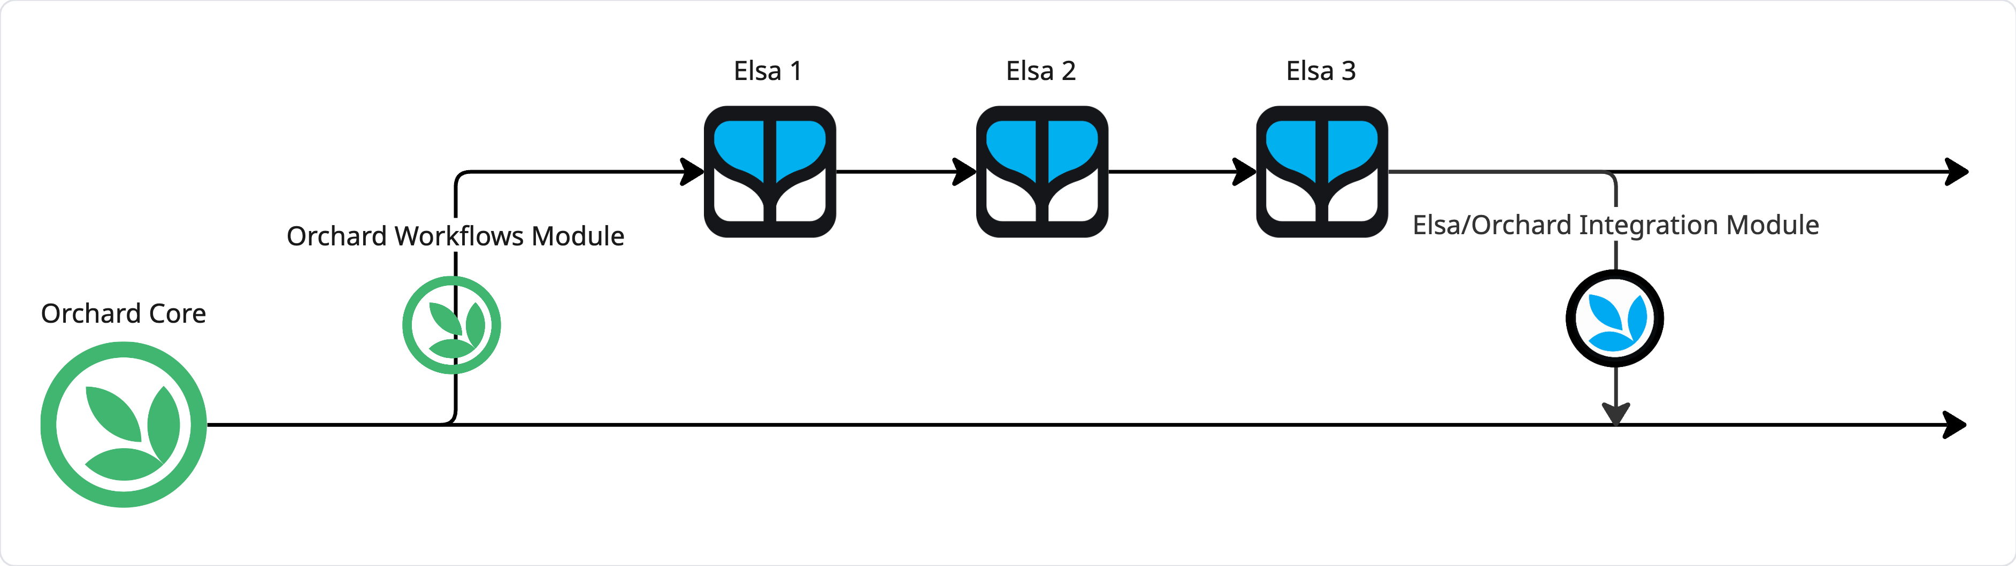
What is Elsa Workflows
A set of NuGet packages for building workflow engines
Open Source + MIT
Offshoot of Orchard Core Workflows
Orchard Harvest
Conference 2025

Slide 5
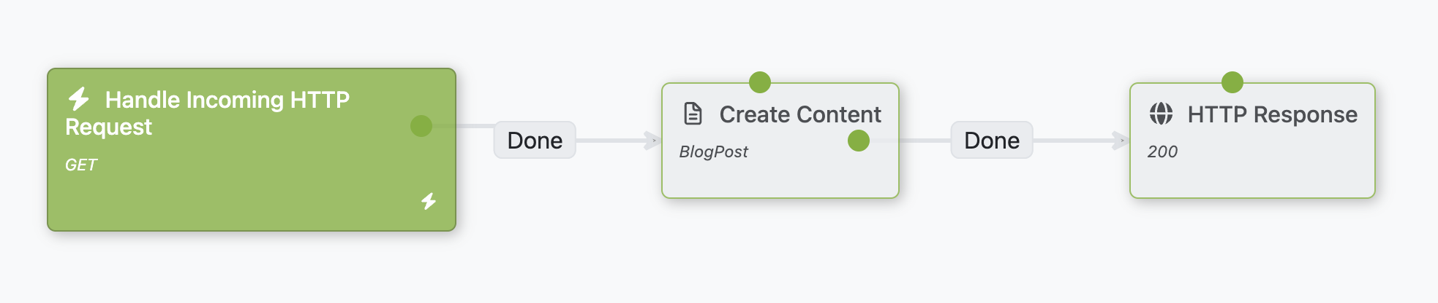
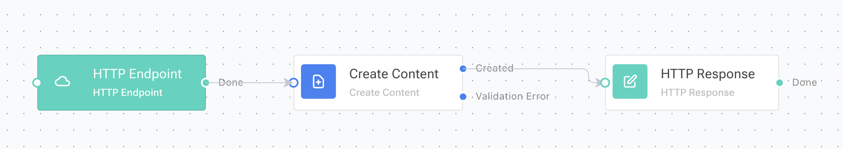
Orchard/Elsa Workflows Similarities
Short + long running workflows
Extensible
Web based designer
.NET
Awesome
Orchard Harvest
Conference 2025

Slide 6
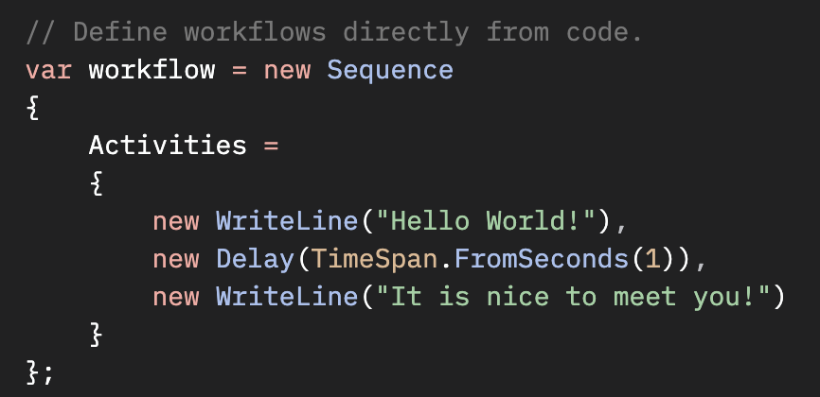
Orchard/Elsa Workflows Differences
Standalone workflow engine and framework
Reuse in any .NET app
Focus on being an embeddable workflow runtime
Composable Activity Architecture
Activity within Activity
Reusable Workflows as Activities
Dynamic Activities from Sources
Dynamic Expressions for any input
JavaScript, C#, Python, Liquid
Code-first Workflows
Workflows from any source (DB, Azure, custom)
Versioned Workflows
Concurrent & Distributed Activity Execution
Orchard Harvest
Conference 2025

Slide 7

Orchard/Elsa Workflows
Similar capabilities
With extras & decoupled
But still a .NET workflow engine
Orchard Harvest
Conference 2025

Slide 8

Elsa Workflows + Orchard
Direct access to Orchard Application Framework
Content Item APIs & Events
GraphQL
SQL
Etc.
Advanced workflow capabilities
Nested activities & workflows
Versioned workflow definitions
Run any Activity in the Background
Concurrent & Distributed Activity Execution
Orchard Harvest
Conference 2025

Slide 9
Demo
Basics
Hello World Console
Hello World HTTP
Integration with OC
HTTP API Integration
Execute SQL Query
Auto fix Blog Posts
Orchard Harvest
Conference 2025

Slide 10
Custom Activity Development
Anatomy of an Activity
Input -> Execute -> Output
Sample: Sum
Sourced Activities
UI
Orchard Harvest
Conference 2025

Slide 11
What’s Next
Hardening for official package release
More integrations
Cloning
UX Improvements
Bulk actions
Import / export
More features
Shapes to integrate admin UI with workflow bindings
Action buttons on Content Item Editor (e.g.,, “Review”, “Improve”)
User Tasks
Review suggestions from AI & Apply
Approval
Server Side Blazor?
Dark Mode
Orchard Harvest
Conference 2025

Slide 12
Thanks for Watching!
Source code
Modules: https://github.com/elsa-workflows/elsa-orchard-core
Demo: https://github.com/sfmskywalker/orchard-harvest-2025
Social
http://www.elsa-x.io
https://github.com/sfmskywalker
https://x.com/sfmkywalker
https://www.linkedin.com/in/sfmskywalker

